Slide 1
CAPER: A Cross-Application Permissioned Blockchain
——VLDB 2019
Mohammad Javad Amiri & Divyakant Agrawal & Amr El Abbadi
Department of Computer Science, University of California
刘志豪

Slide 2
Outline
Introduction
Motivation
Architecture
Consensus
Experiment
Conclusion

Slide 3
Blockchain, originally devised for the Bitcoin cryptocurrency, is a distributed data tructure for recording transactions maintained by nodes without a central authority.
There exist two type of BlockChain, i.e., permissioned and permissionless.
Collaborations are defined in service level agreements (SLAs) which are agreed upon by all involved applications. SLAs can be written as self executing computer programs, called smart contracts.
Distributed applications require high performance in terms of throughput and latency.

Slide 4
Motivation
Existing permissioned blockchains mostly suffer from performance issues in terms of throughput and latency because of the sequential execution of transactions on all nodes, and also confidentiality issues since a single blockchain ledger with all transactions is maintained at every node.
In a permissioned blockchain, batching transactions into blocks decreases performance (Since proof-of-work is not required ). Thus, each block consists of a single transaction.
In CAPER, each application orders and executes its internal transactions locally while cross-application transactions are public and visible to every node. In addition, the blockchain ledger of CAPER is a directed acyclic graph that includes the internal transactions of every application and all cross-application transactions.

Slide 5
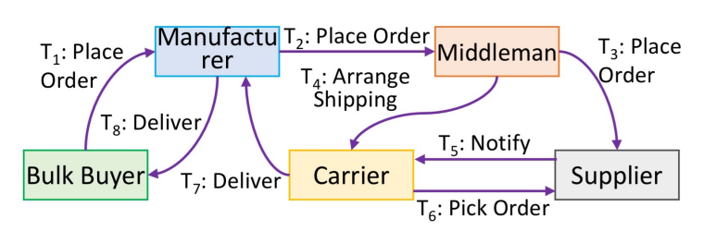
Example
Supply Chain scenario
Internal tasks
Cross tasks
Fault
SLAs

Slide 6

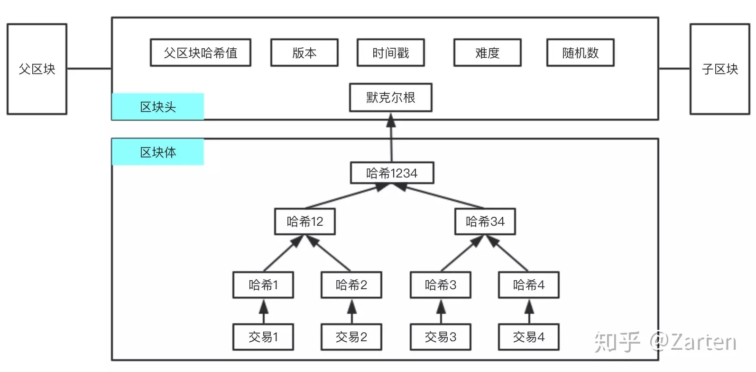
The structure of permissionless blockchain

Slide 7
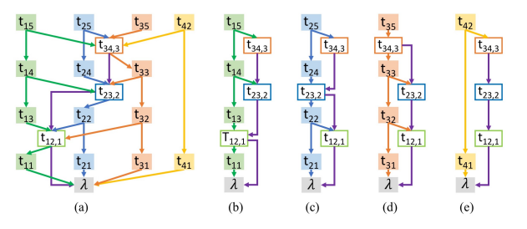
The structure of permissioned blockchain
A total order between all transactions that are initiated by an application.
A total order between cross-application
transactions.
An internal transaction of an application might include the cryptographic hash of a cross-application transaction
DAG
Batching transactions into blocks decreases performance (Since proof-of-work is not required)
Ordered
Confidentiality

Slide 8
ARCHITECTURE
We use N and A to denote the set of nodes and applications. In addition, Nα indicates the set of agents of application α ∈ A where for each pair of applications α1 and α2 in A, Nα1 ∩ Nα2 = ∅.
Messages may contain public-key signatures and message digests.
There are two type of levels of malicious behavior in the system, node level and application level, these two levels of behavior are independent of each other.
Ordering the transactions within each application needs consensus among the agents of the application. To establish consensus, state machine replication algorithm can be used.
  safety: all correct nodes receive the same requests in the same order.
  liveness: all correct client requests are eventually ordered.

Slide 9
LOCAL CONSENSUS IN CAPER
The local consensus protocols in CAPER are pluggable.
Execute an internal transaction proceeds as follows:
  client c requests an internal transaction tx for an application by sending a message <REQUEST, tx, τc, c>σc to the agent primary p.
  p first checks the signature to ensure it is valid, and then initiates a local consensus algorithm by multicasting a message
  The agents then establish agreement on a total order of transactions using the utilized consensus protocol, execute the transaction, and append it to the blockchain ledger.
  Either the primary or every agent node sends a reply message
  <REPLY, τc, u>σo to client c where tsc is the timestamp of the corresponding request and u is the execution result.

Slide 10
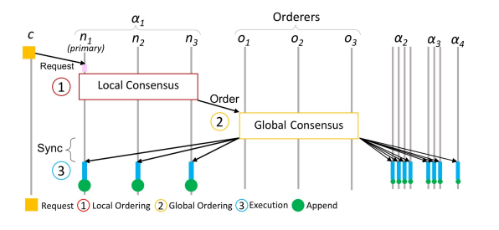
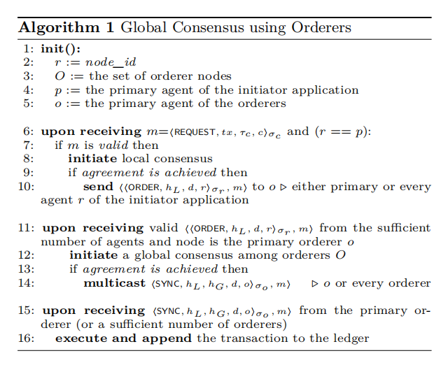
Global Consensus using a Separate Set of Orderers
hL:the hash of the previous application initiated by the application
hG:the hash of the previous cross-application transaction

Slide 11
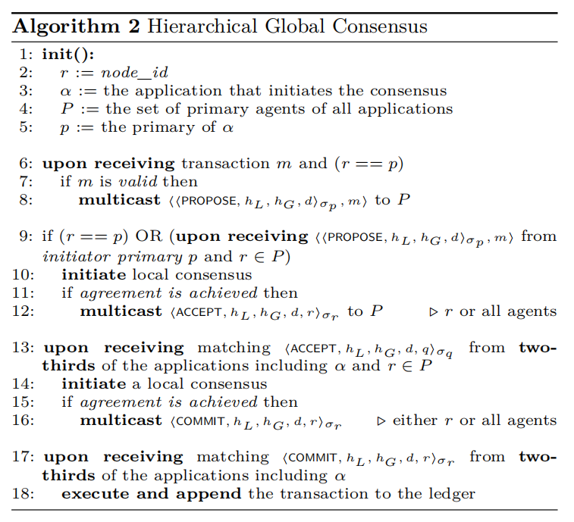
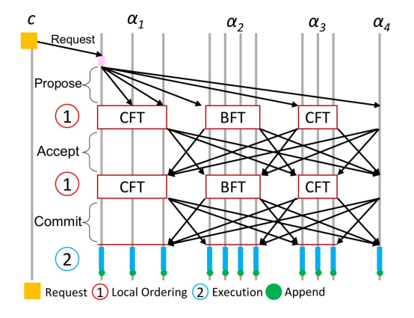
Hierarchical Global Consensus

Slide 12
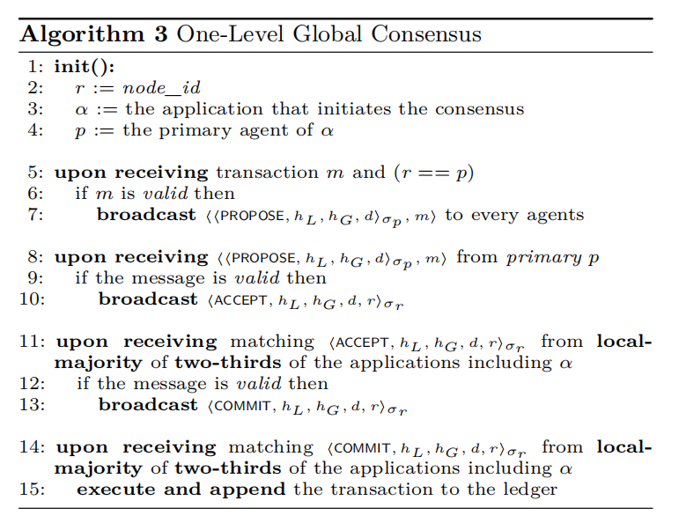
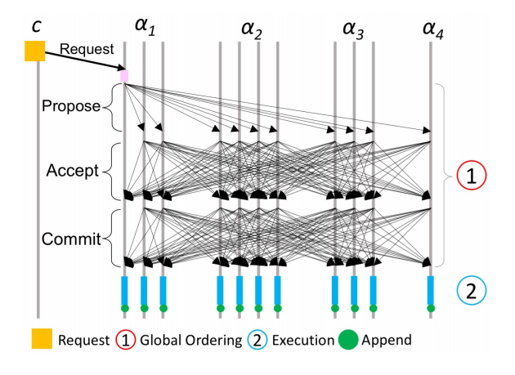
One-Level Global Consensus

Slide 13
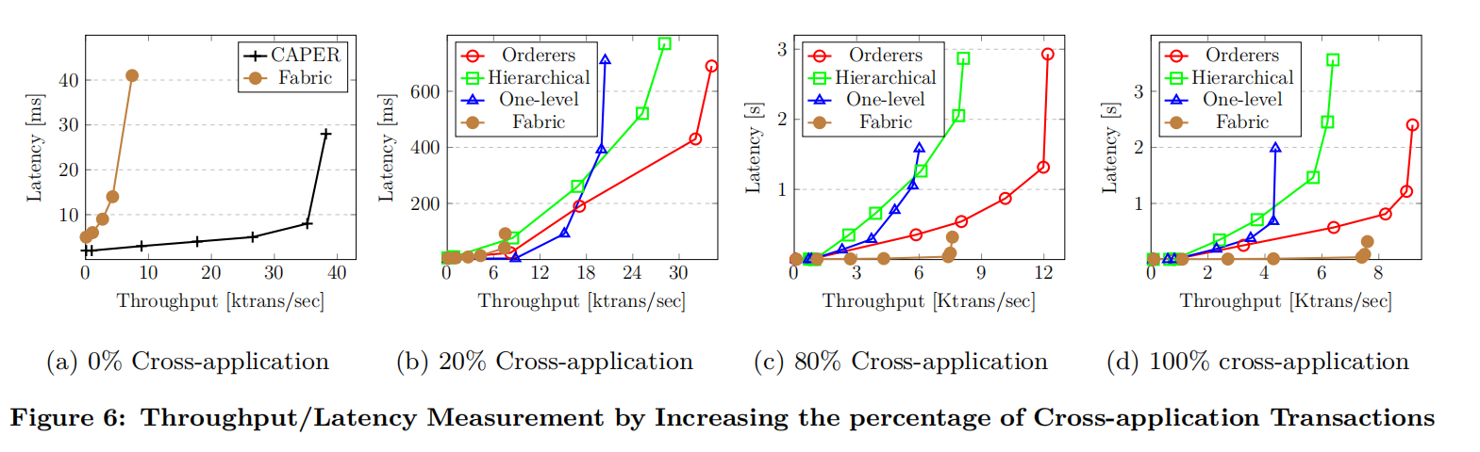
Experiment

Slide 14
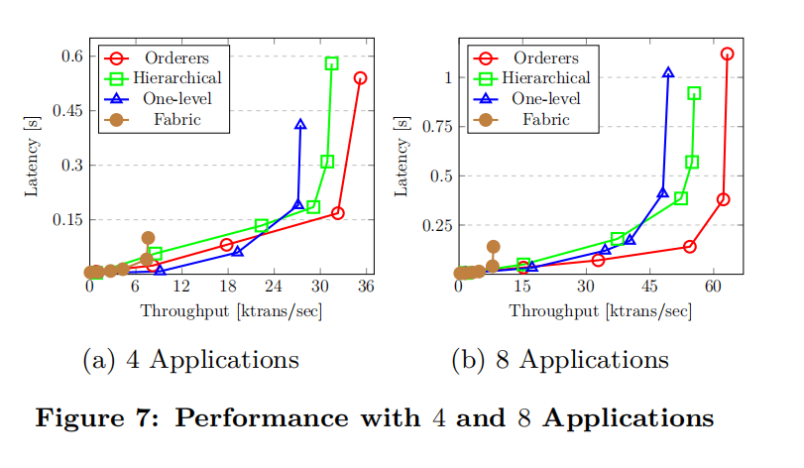
Experiment
90% internal and 10% cross-application transactions

Slide 15
Conclusion
CAPER is a permissioned blockchain system that supports both internal and cross-application transactions of collaborating distributed applications.
To achieve better performance, CAPER orders and executes internal transactions of different applications simultaneously.
To achieve confidentiality, each application maintains its own view of the ledger including its internal and all cross-application transactions.
For lightly loaded cross-applications one-level consensus shows better performance whereas using a set of orderers is more beneficial for heavily loaded applications.
In the absence of extrare sources for orderers, the hierarchical approach can provide better performance in heavily loaded applications.

Slide 16
Thank You

